Slide 1

Mini Project (KCA353) Odd Semester Session 2024-25
ChatBot for National Consumer Helpline
Shubhanshu Mohan – 2300290140180 Sumit Singh – 2300290140187 Vishal Yadav – 2300290140206
Project Supervisor:
Shweta Singh
Assistant Professor

Slide 2
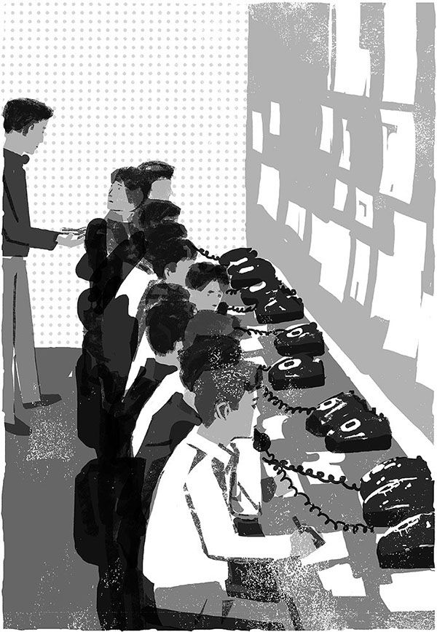
ChatBot for
National Consumer Helpline
This project aims to provide efficient, accessible, and responsive assistance to consumers by addressing common queries, facilitating the submission and tracking of complaints, and improving user experience through quick resolutions, multilingual support, and seamless escalation to human agents when necessary.

Slide 3
Project Abstract
Overview
Key Objectives
Approach
The National Consumer Helpline (NCH) chatbot project seeks to develop an AI-powered digital assistant to improve consumer support services. The chatbot will provide quick responses to common consumer inquiries, facilitate complaint filing, offer tracking and escalation options, and ensure accessibility for users across languages and regions.
Natural Language Processing (NLP )
Multilingual Support
Self-service Capabilities
Continuous Improvement
Enhance Accessibility
Automate Consumer Support
Reduce Response Time
Data Collection

Slide 4
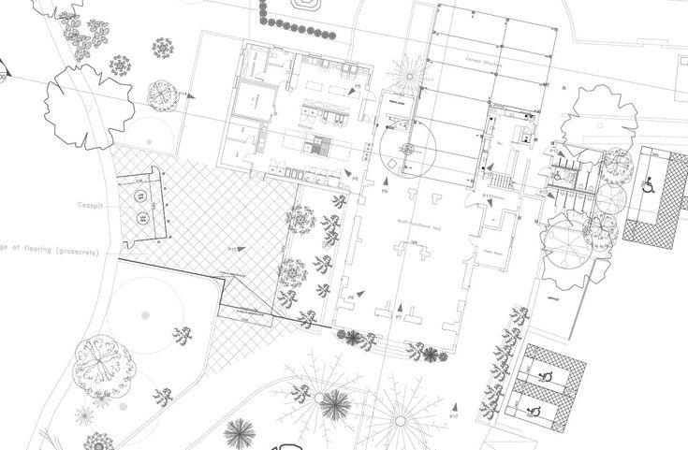
Project Goals and Objectives
Automate Complaint Management
1
Allow consumers to lodge complaints through the chatbot, with automatic categorization and routing of issues.
Improve Query Resolution
2
Provide instant answers to common
consumer-related questions regarding rights,
procedures, and laws.
Increase Accessibility
3
Ensure that consumers from diverse backgrounds and regions can access the helpline services easily, irrespective of time or location.

Slide 5
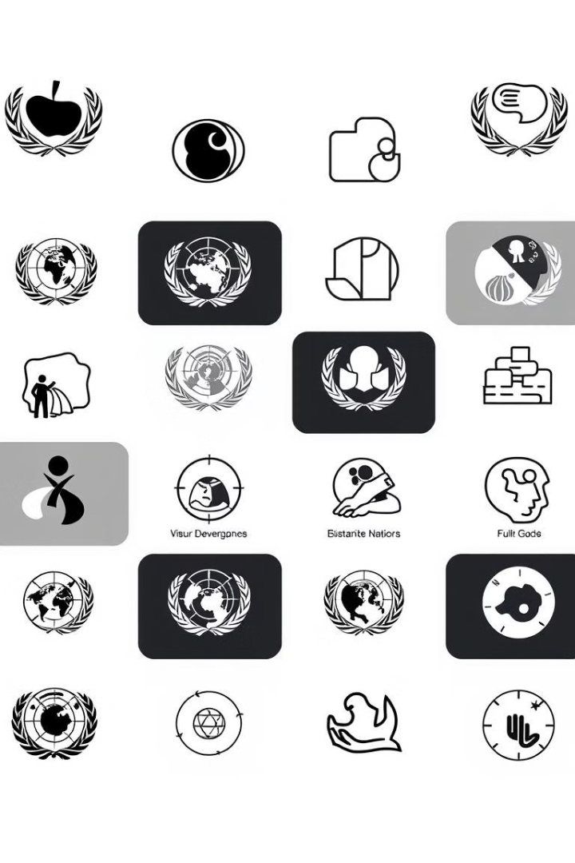
Alignment with UN Sustainable Development Goals (SDGs)
SDG 1: No Poverty
SDG 5: Gender Equality
Providing equal access to consumer protection services for low-income and marginalized communities.
Offering equal support to all consumers, regardless of gender, and ensuring access to consumer services without discrimination.
SDG 8: Decent Work and Economic Growth
SDG 9:Industry,Innovation, and Infrastructure
Streamlining consumer complaint processes and offering efficient resolution mechanisms, fostering trust in consumer markets.
Developing a technological solution that facilitates faster, more efficient consumer service through AI and chatbot technologies.

Slide 6





Methodology and Approach
Requirements Gathering and Analysis
Consult with stakeholders (government agencies, consumer rights groups) to identify key needs.
System Design and Architecture
Deploy advanced solar, wind, and energy storage technologies to maximize clean energy generation.
Development and Training
Train the chatbot using data sets of FAQs, consumer complaints, and laws.
Implement multilingual capabilities to support diverse languages.
Implementation and Deployment
Launch a pilot phase to assess performance and gather user feedback.
Roll out the chatbot nationwide after addressing pilot feedback.

Slide 7



Expected Outcomes and Impact
Improved Accessibility to Consumer Services
Reduction in Operational Costs
Higher Consumer Satisfaction
Consumers will have 24/7 access to consumer services via the chatbot, making it easier to lodge complaints, track cases, and get immediate answers to their queries.
By automating routine tasks like answering FAQs, registering complaints, and providing updates, the chatbot will reduce the dependency on human agents for basic support.
Consumers will experience quicker responses, personalized guidance, and seamless tracking of their complaints through the chatbot.

Slide 8
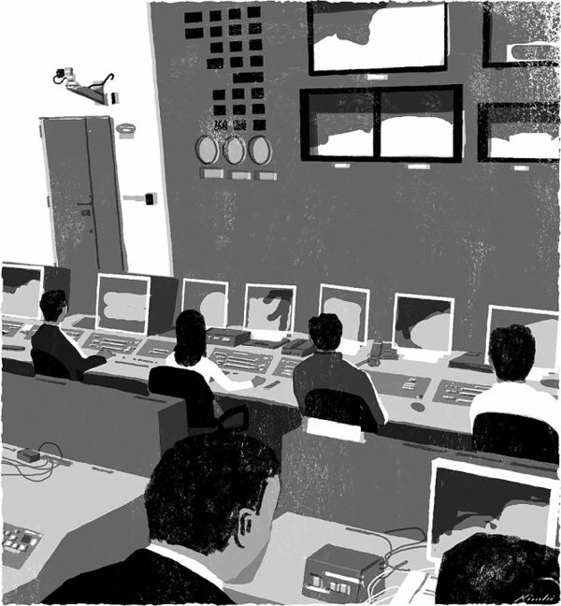
Key Project Deliverables
A dashboard for monitoring chatbot performance, user interactions, and issue resolution rates in real-time.
Real-Time Analytics Dashboard
A plan for ongoing updates, improvements, and monitoring based on user feedback, performance data, and evolving needs.
Post-Launch Evaluation and Continuous Improvement Plan

Slide 9

Next Steps and Conclusion
Refine NLP and Voice Processing
1
Integrate NCH voice support to enhance voice recognition and processing.
2
Implement Image Recognition
Add an image recognition model if the chatbot needs to interpret visual inputs (e.g., identifying objects in an image, understanding text within images).

